Slide 1
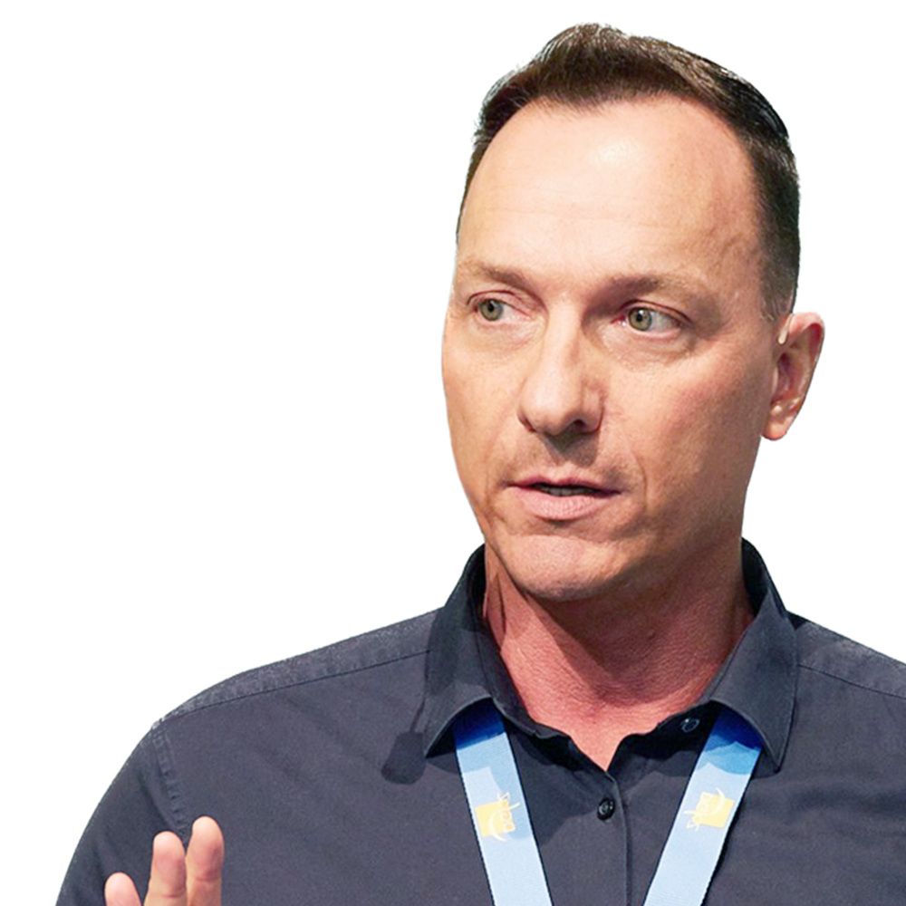
Root caries: The challenge in today’s cariology Prof. Roland Frankenberger
Special offers for webinar participants Offers available in Europe, Middle-East and Africa only

Slide 2
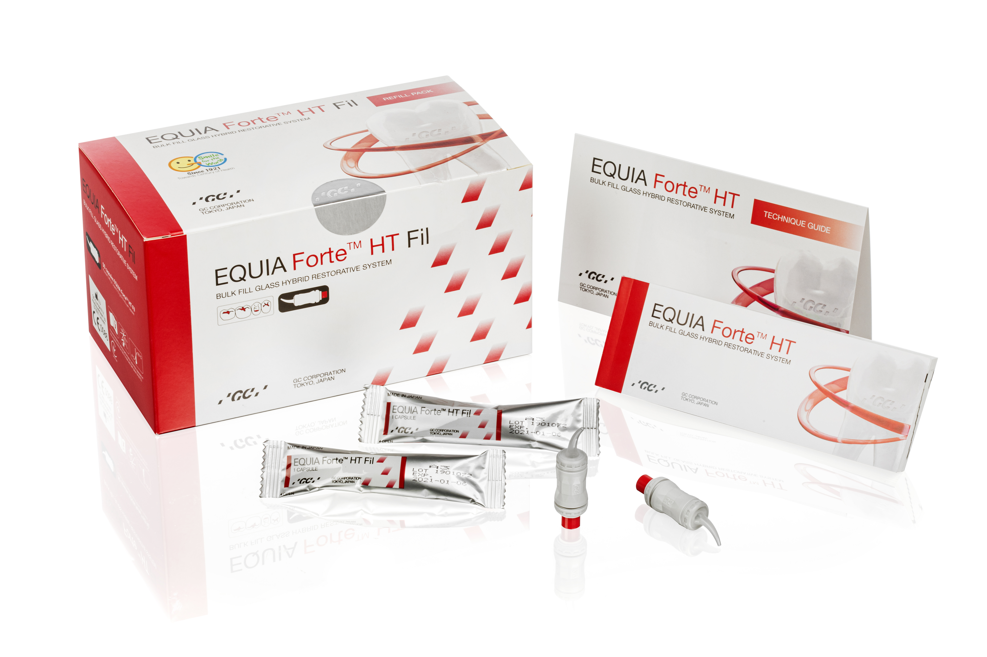
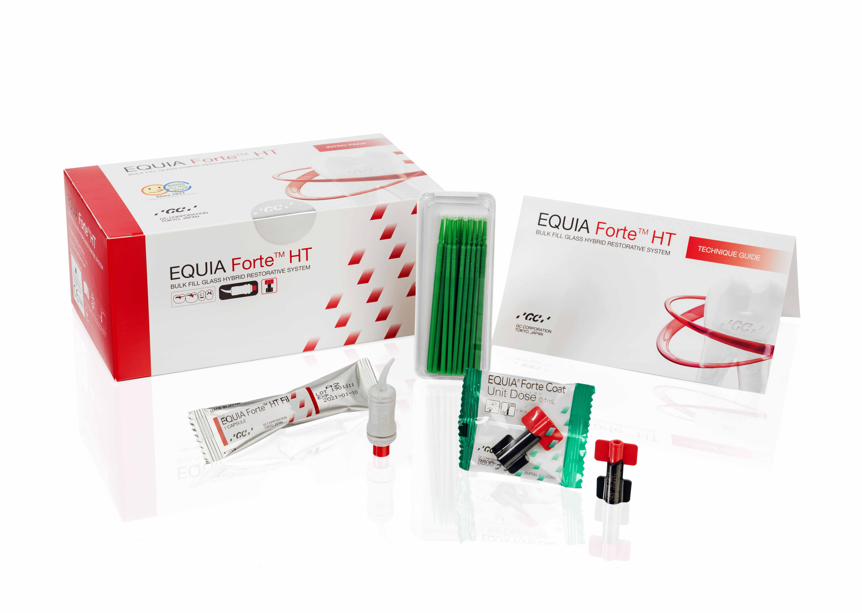
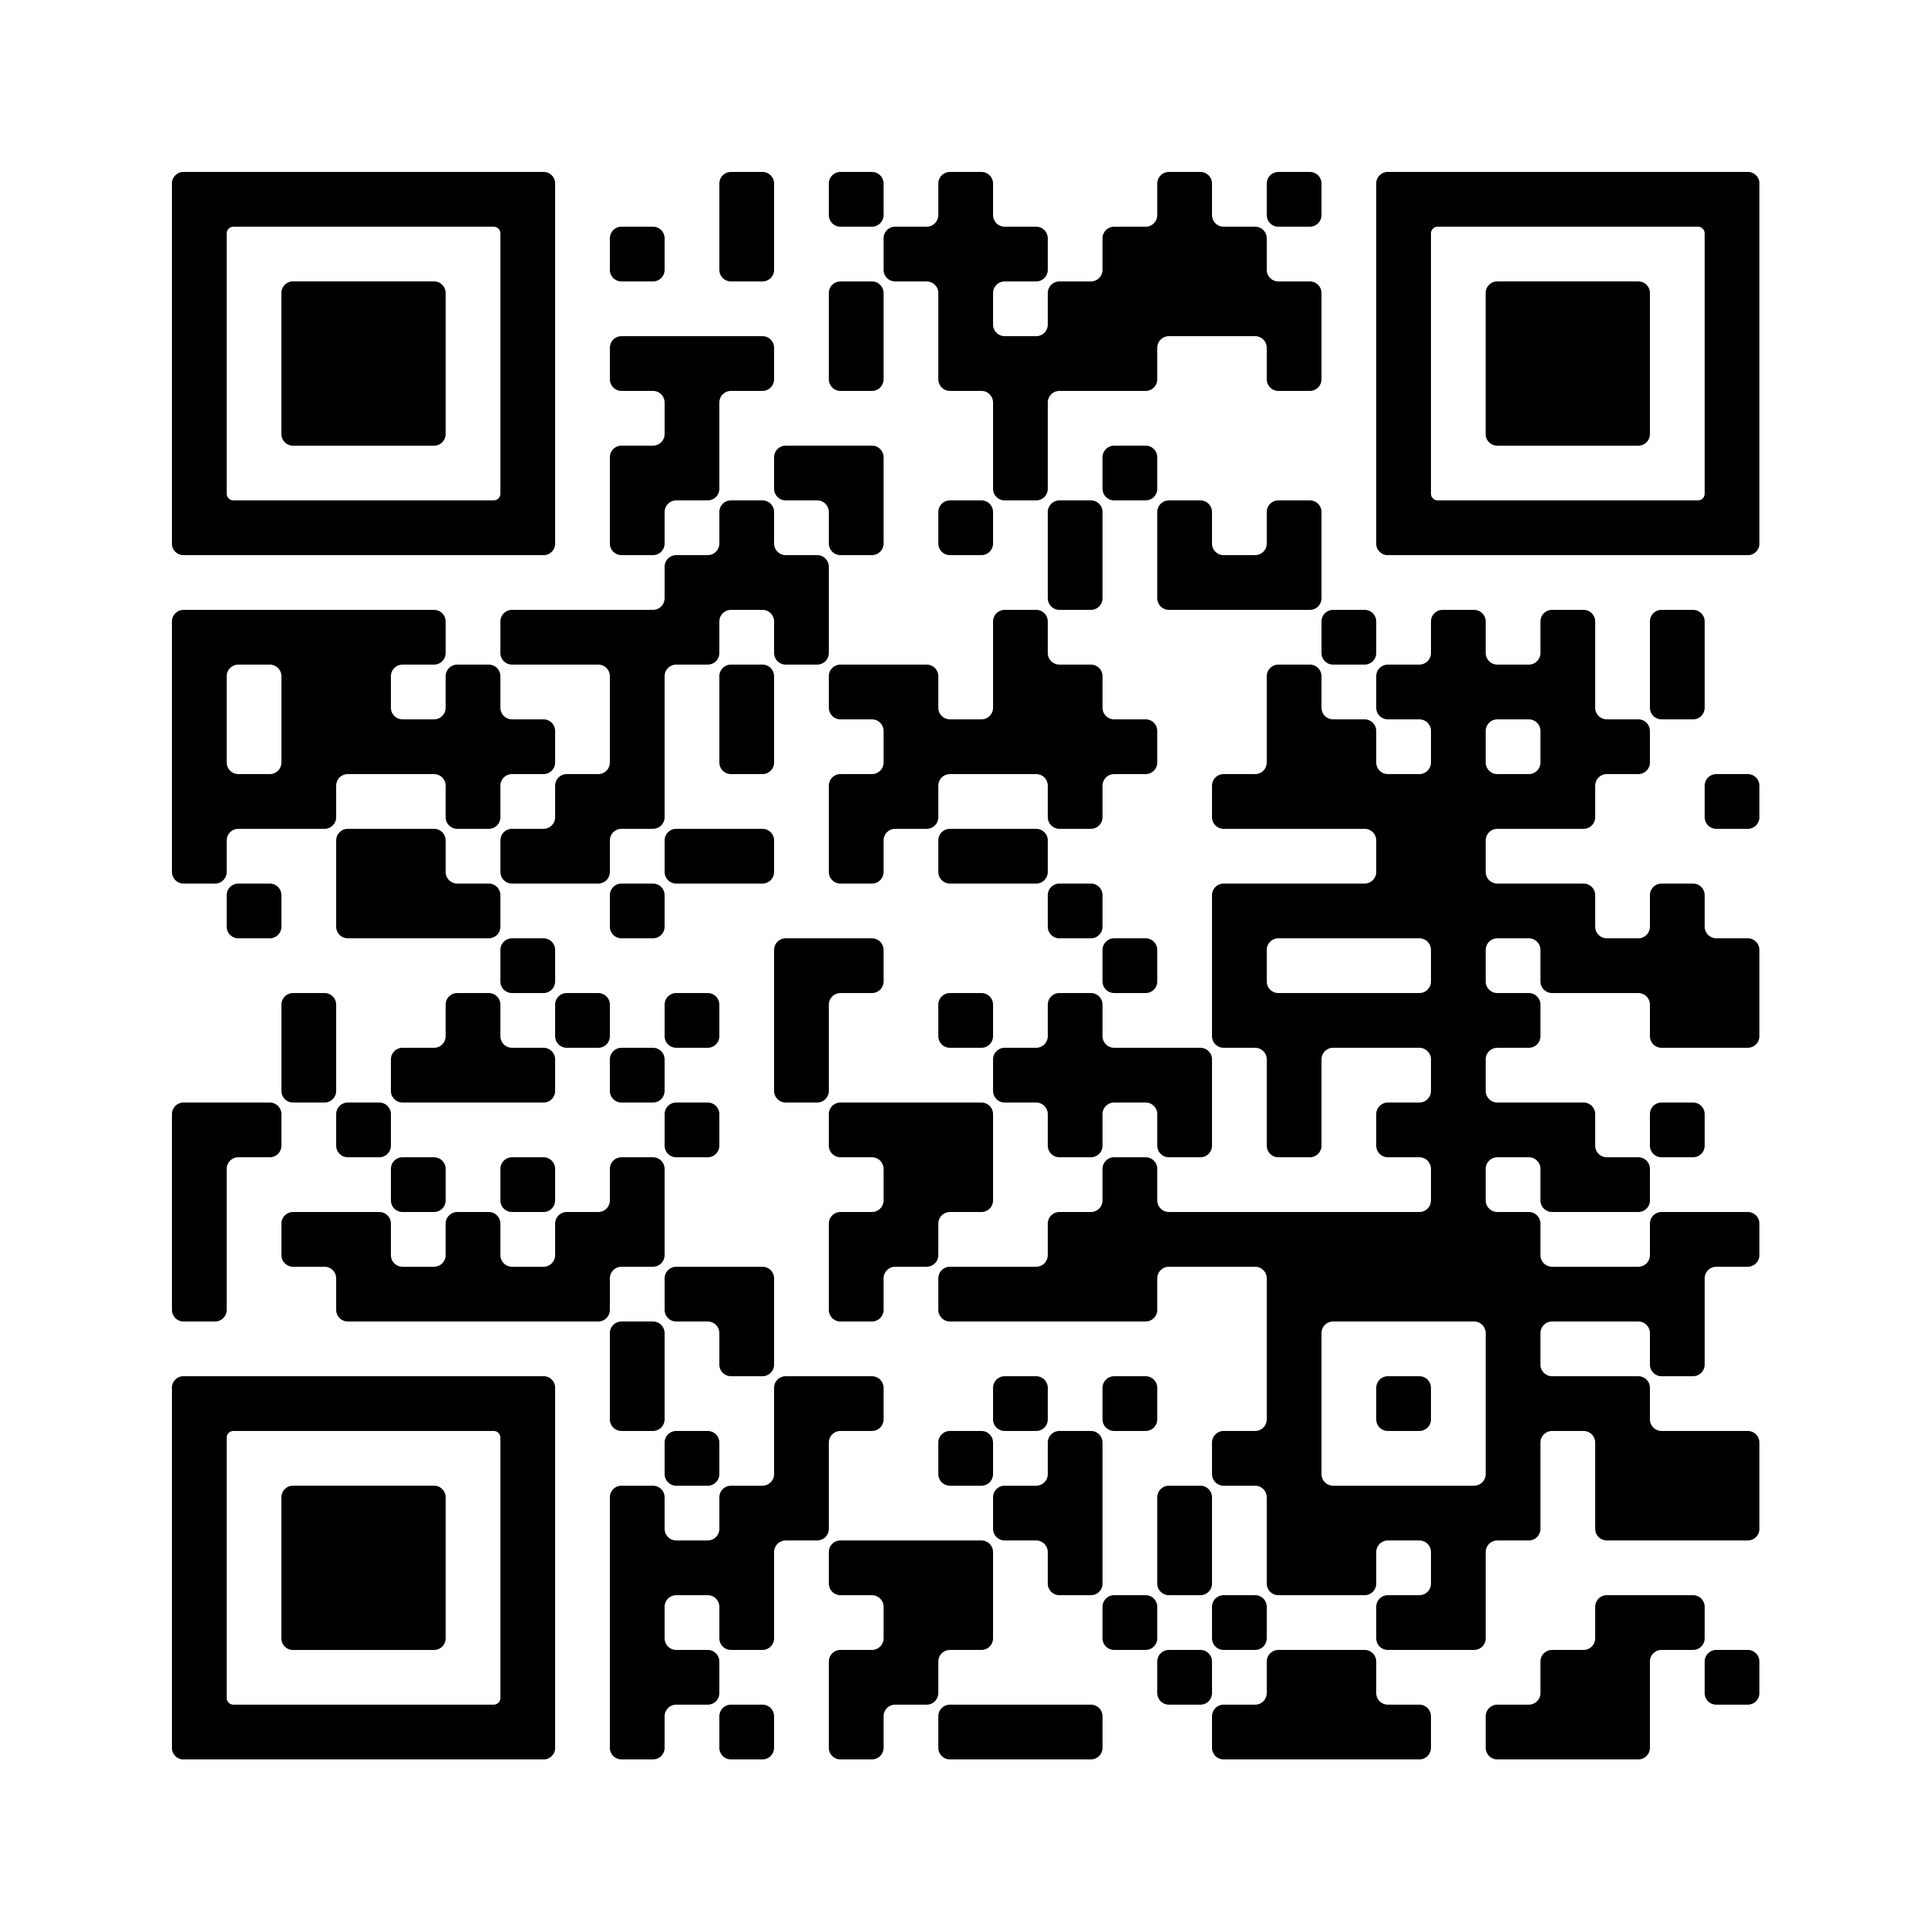
Special offer for webinar participants
Buy 2
EQUIA Forte HT refill packs
Box with 50 Capsules EQUIA Forte HT Fil
Get 1
EQUIA Forte HT intro pack
FREE of CHARGE
20 Capsules EQUIA Forte HT Fil, 20 Unit doses of
EQUIA Forte Coat & 25 Disposable applicators
To take advantage of this offer we kindly ask you to contact your local GC Sales office.
The offer is valid until the 31st of May 2024
Offer available in Europe, Middle-East and Africa only

Slide 3
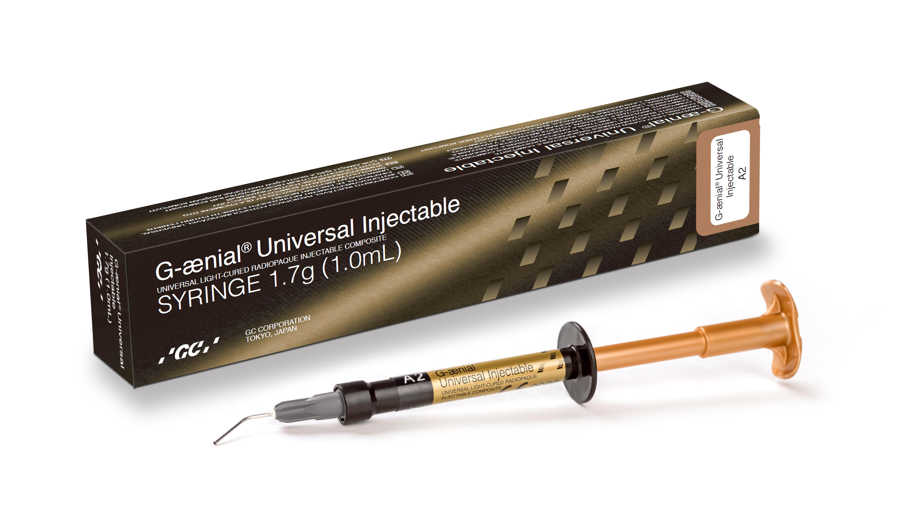
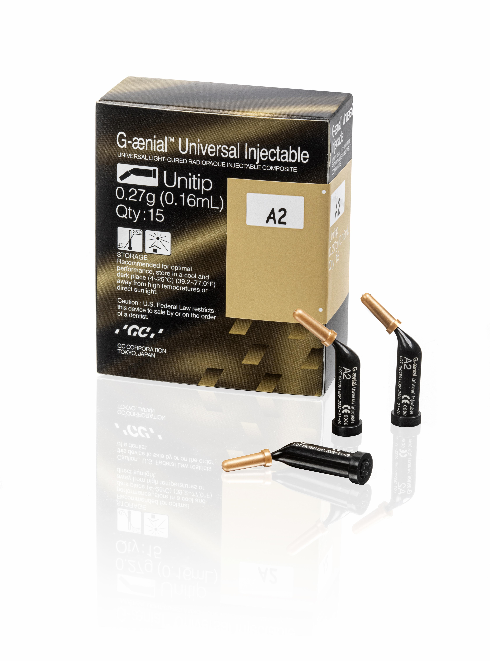
Special offer for webinar participants
Buy 5 G-ænial Universal Injectable refills
GC G-ænial Universal Injectable, Syringe 1ml all colours
GC G-ænial Universal Injectable, Unitip 15x0.16mL all colours
Get 1 G-ænial Universal Injectable refill
FREE of CHARGE
To take advantage of this offer we kindly ask you to contact your local GC Sales office.
The offer is valid until the 31st of May 2024
Offer available in Europe, Middle-East and Africa only

Slide 4
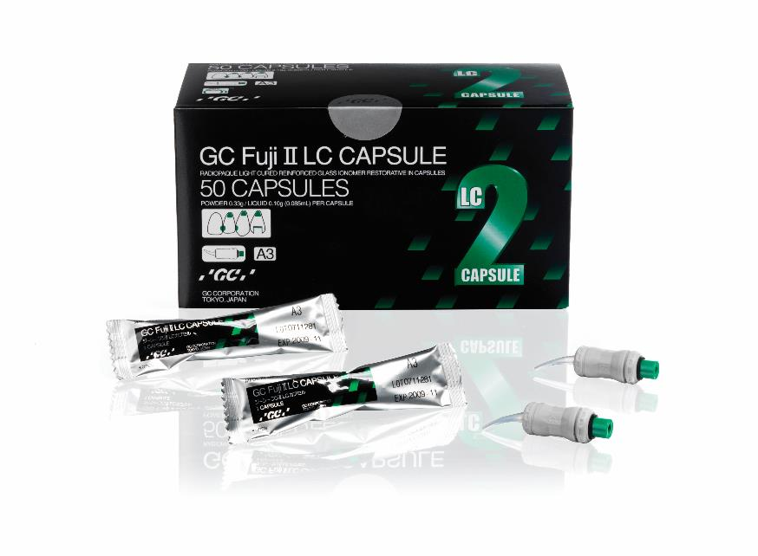
Special offer for webinar participants
Buy 3 GC Fuji II LC refills
Box with 50 Capsules GC Fuji II LC
Get 1 GC Fuji II LC refill FREE of CHARGE
To take advantage of this offer we kindly ask you to contact your local GC Sales office.
The offer is valid until the 31st of May 2024
Offer available in Europe, Middle-East and Africa only

Slide 5
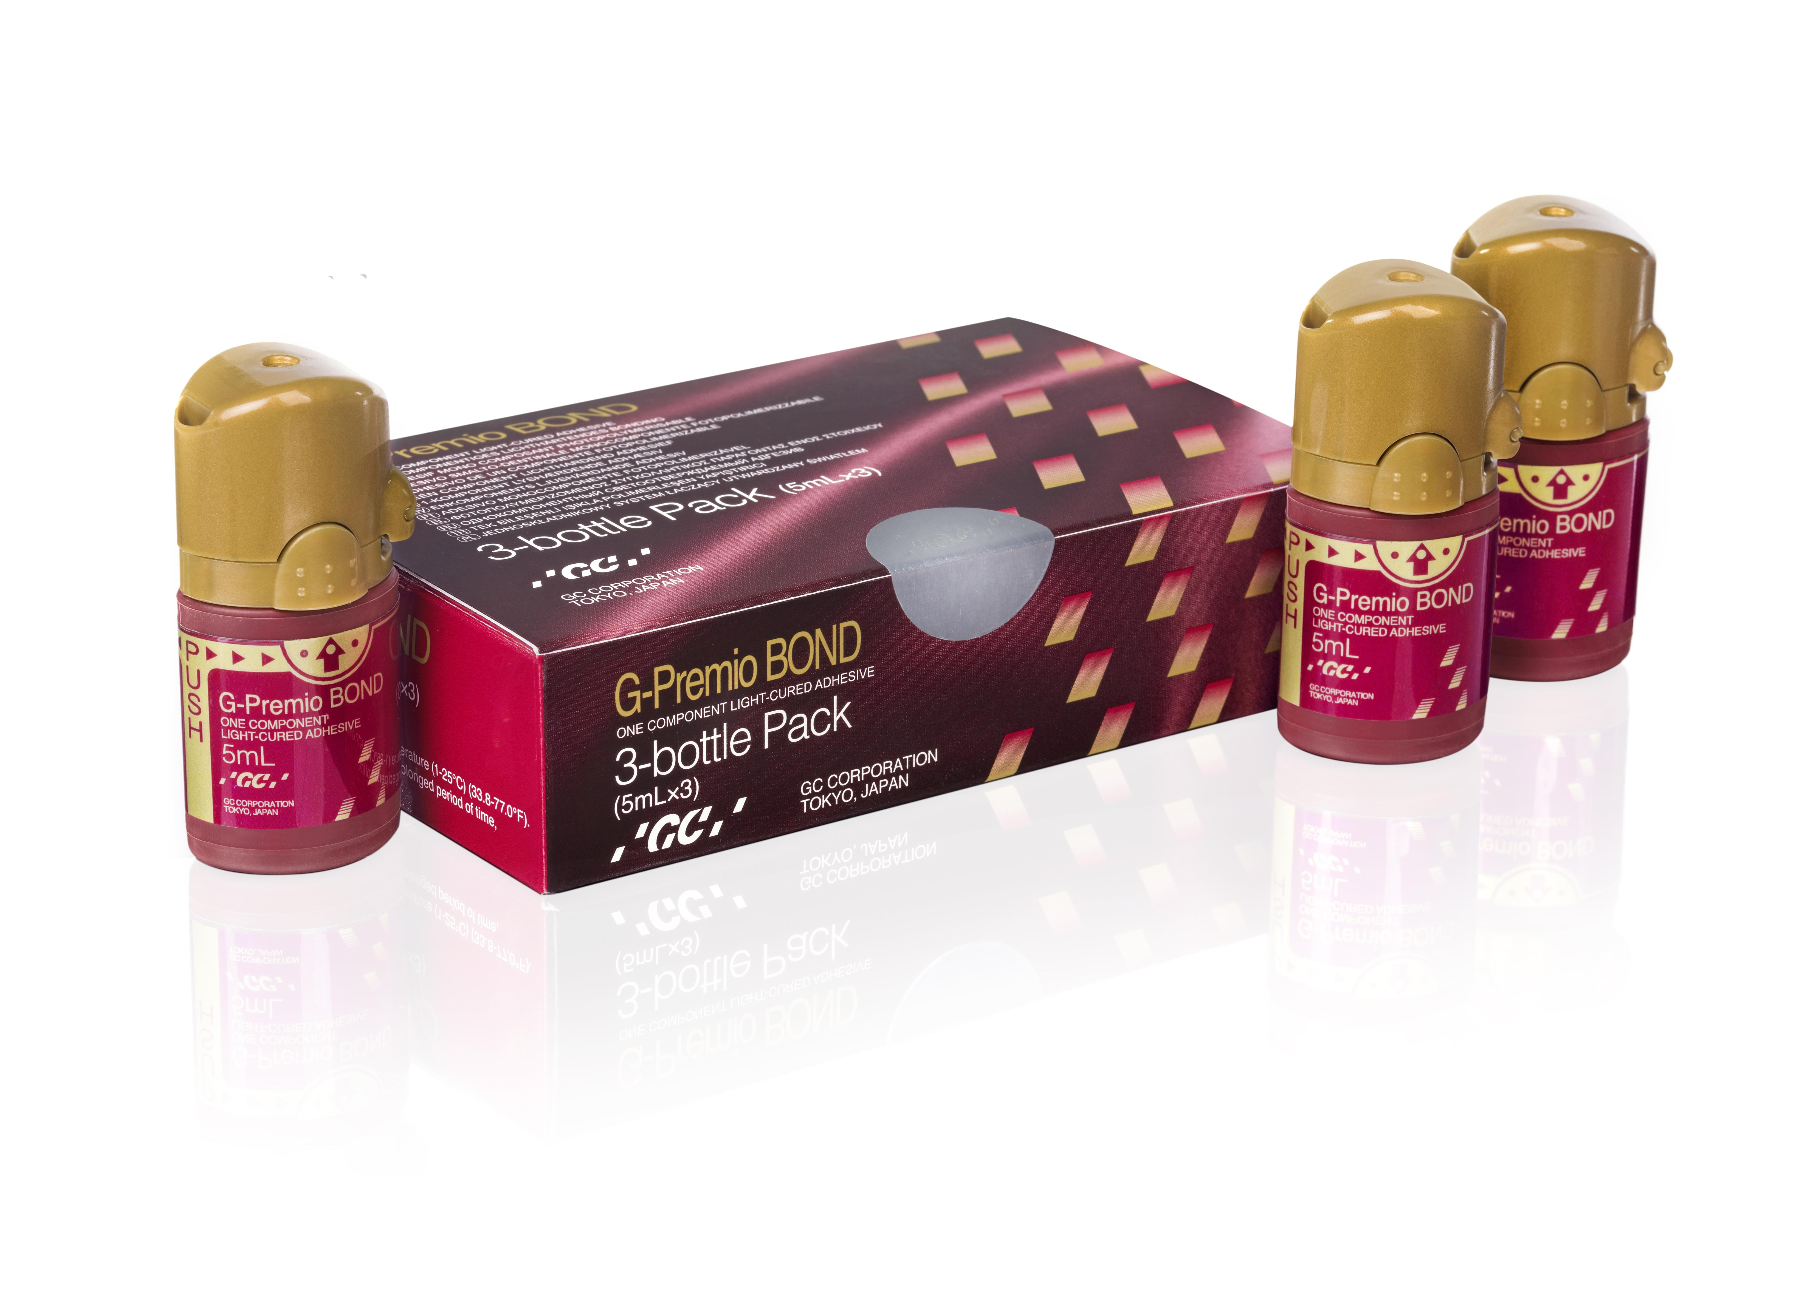
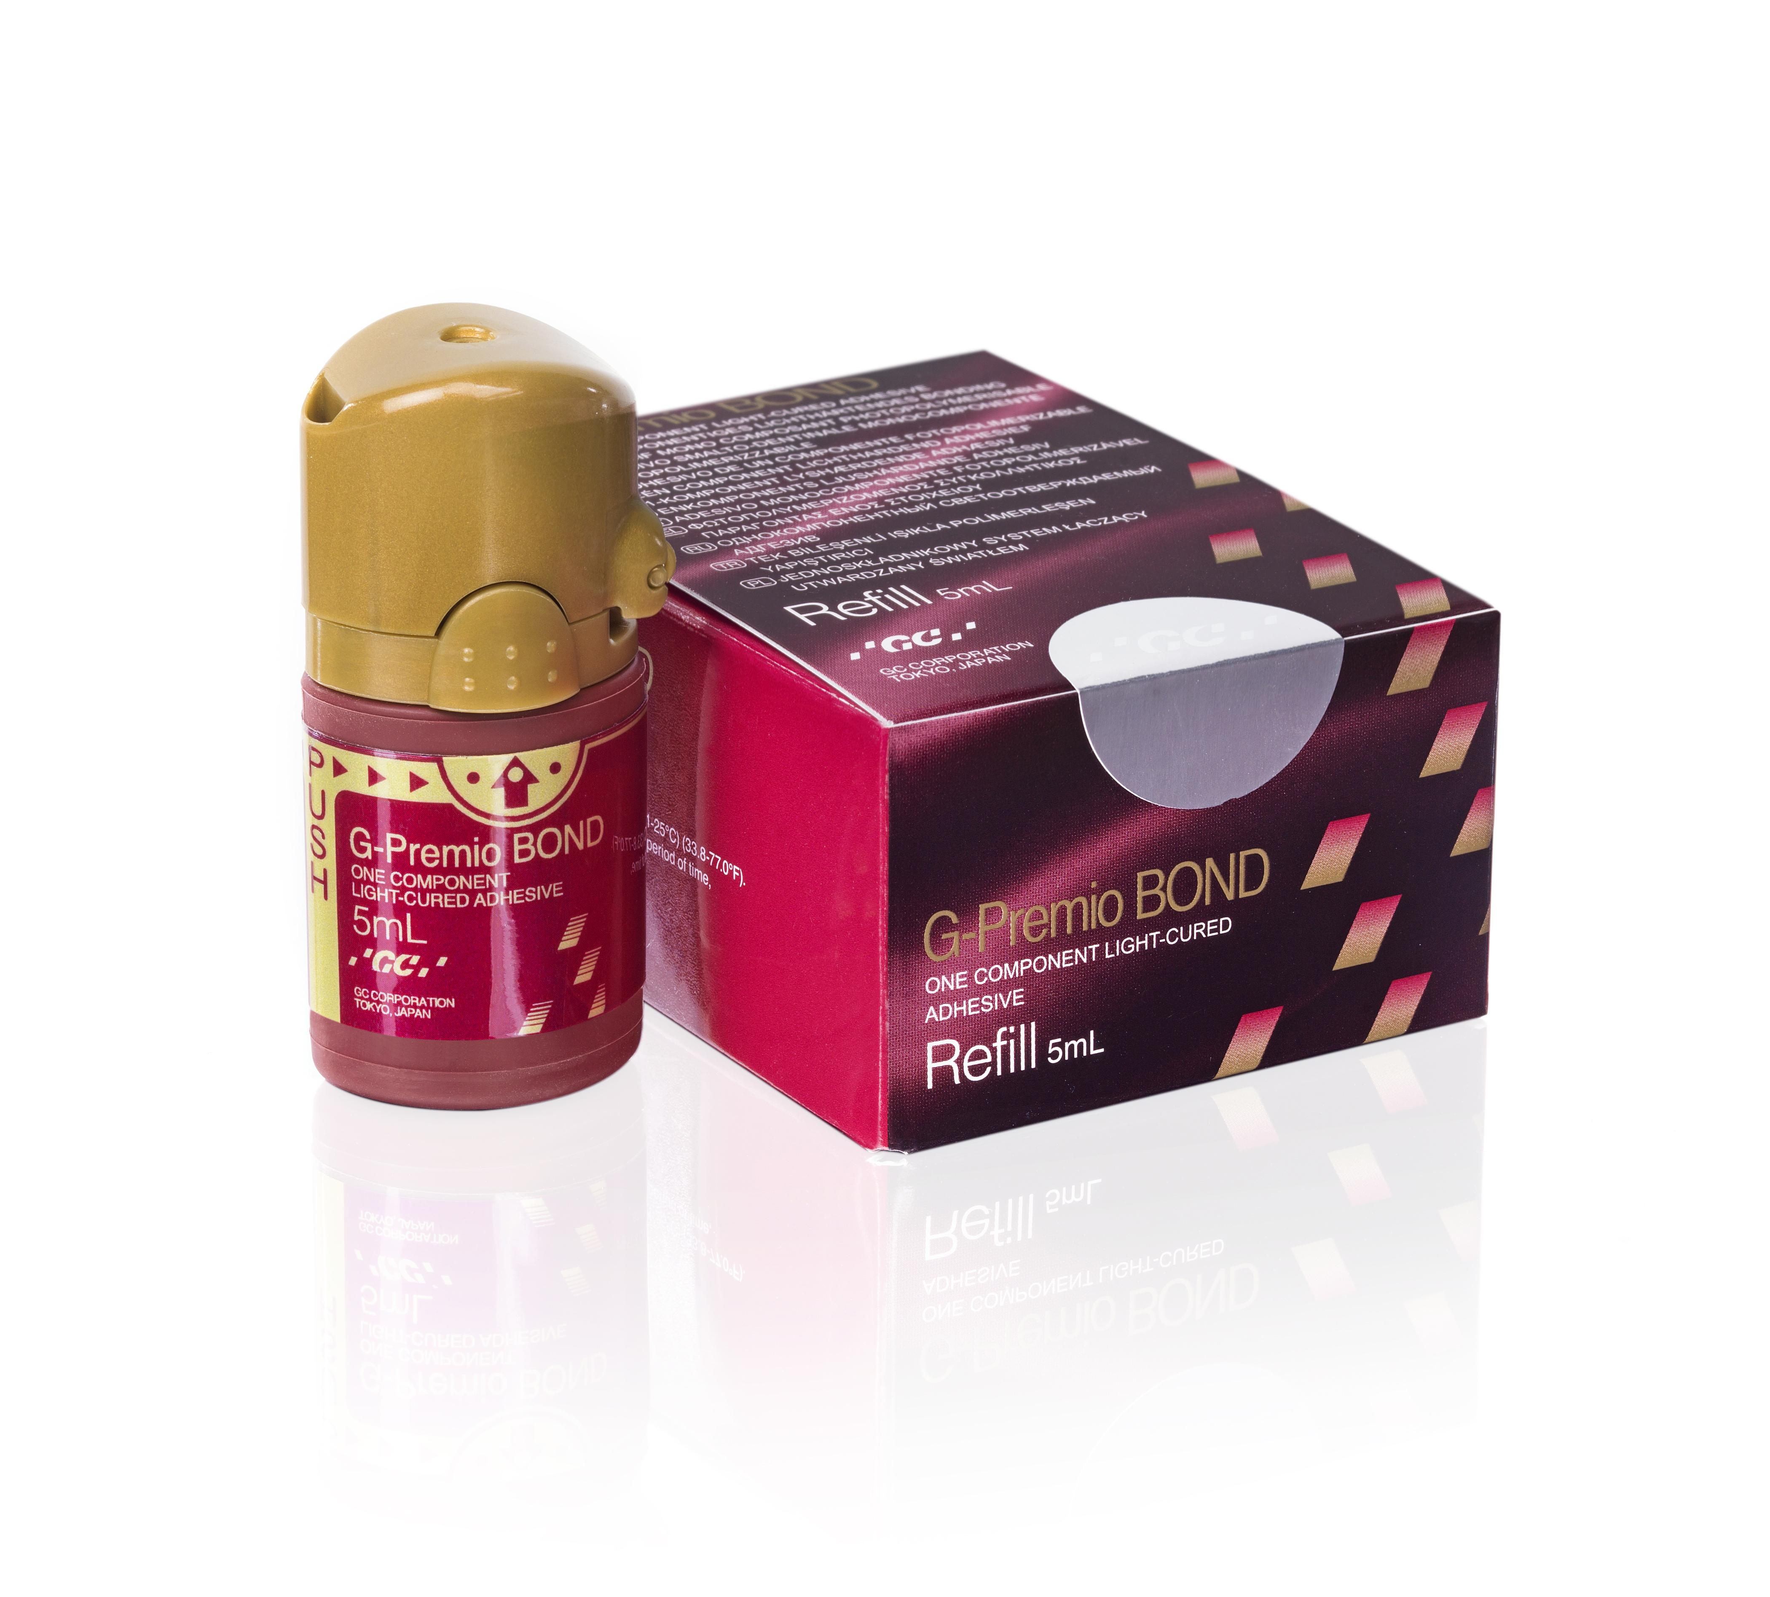
Special offer for webinar participants
Buy 1
G-Premio Bond 3-bottle pack
3x Bottle 5ml G-Premio Bond
Get 1
G-Premio Bond refill
FREE of CHARGE
1x Bottle 5ml G-Premio Bond
To take advantage of this offer we kindly ask you to contact your local GC Sales office.
The offer is valid until the 31st of May 2024
Offer available in Europe, Middle-East and Africa only

Slide 6
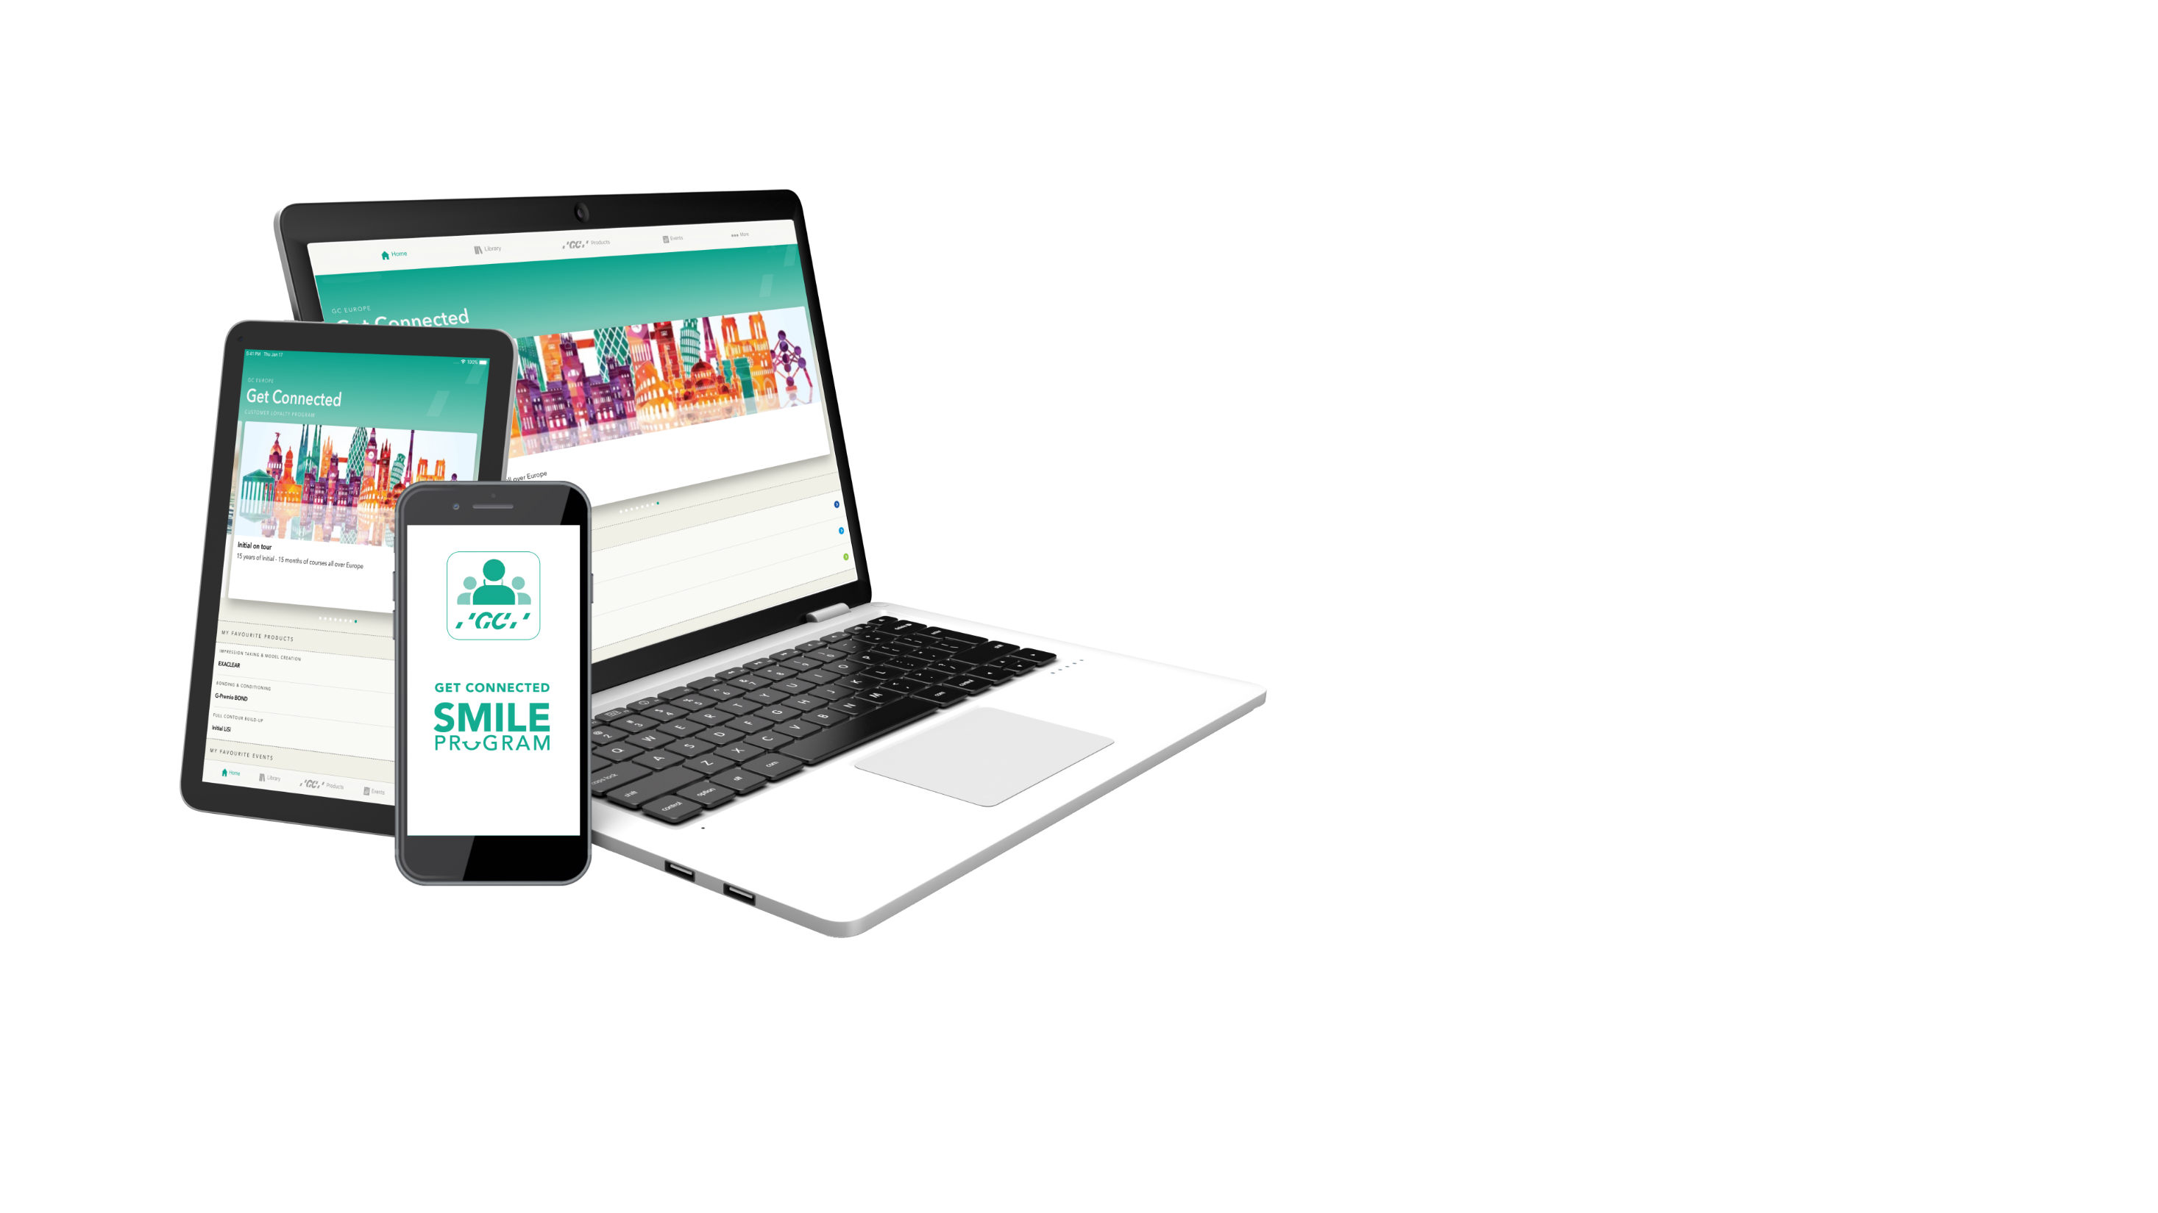
DOWNLOAD NOW
ALL THE TOOLS YOU NEED WITHIN HAND’S REACH!
Get Connected Smiles Program
Stay informed and collect smiles to enjoy professional benefits and advantages

